Slide 1
Visual Design for Instructional Designers
Creating Engaging Slide Presentations
Presented by
Jerson Campos

Slide 2
Introductions
Jerson Campos
Senior Training Specialist @ Smile Digital Health
Instructional Designer: 12+ years
Freelancer/Contractor/Owner: 10+ Years (5-6 solo)
Visual-e-Learning LLC
www.visual-e-learning.com

Slide 3
Agenda
Form Follows Function
Basic Design Principles
Design Elements
C.R.A.P. (PM)
Tips and Tricks (If we have time.)
Notes:
Here is our agenda and the topics I will be discussing. First, I’ll talk about the Form Follows Functions principle and how important it is.
Then I’ll go over some basic design principles. I’ll also discuss some elements that affect your design.
Next we’ll talk about the CRAP principles. Yes, it’s a funny acronym, but it makes it easy to remember.
And if we have some time I’ll share some tips and tricks.
I want to emphasize that since this is a webinar on visual design, when I say design, I’m not including the analysis process. This is strictly about graphic design and development and not instructional design.

Slide 4
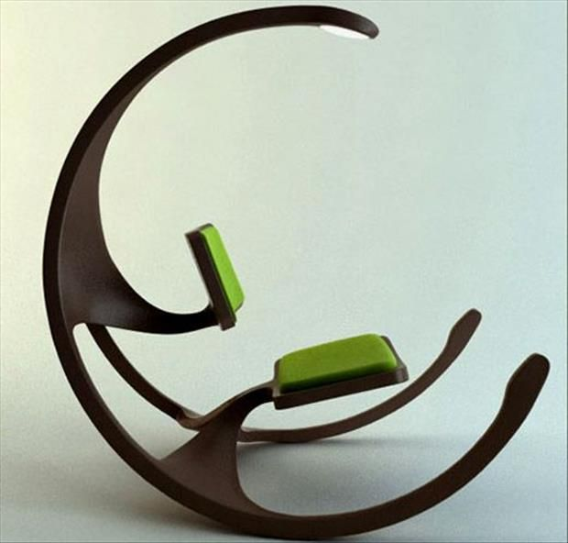
Form Follows Function
Content First
Prioritizing functionality and purpose over purely aesthetic considerations.
Avoid Over Designing
Over designing can distract the user and hamper the learning objectives.
Notes:
Out of the two chairs in the picture, which one do you like? Which would you rather sit in for several hours? Which one would actually go with the rest of your furniture in your office or home?
I’m going to talk about a lot of different graphic design principles, and you may (and should) try them out. But I want I want to emphasis one principle above all else and that is “Form Follows Function”. Form Follows Function is a principle I learned in High School in my drafting class. It is a fundamental concept in design that emphasizes prioritizing functionality and purpose over purely aesthetic considerations. The purpose and content of the course should always come first, design and interactions second. You should never plan or create interactions just for the purpose of adding engagement and try to design the content around it. Over designing or focusing too much on “gimmicks” can distract the user, hamper the learning objectives, and cause “engagement fatigue”.

Slide 5
Basic Design Principles
Hierarchy
Contrast
Alignment
Balance
Color
Texture
Proximity
Movement
Repetition
Emphasis
Proportion
Rhythm
Space
Typography
White Space
+ More
Notes:
Here is a small list of some basic design principles and elements that go into the graphic design process. I won’t be covering all these topics because we only have an hour. Many of these principles can be a whole course within themselves, such typography and color theory. I will be covering the ones that I feel are important for someone in the instructional design field and new to graphic design to learn and incorporate as part of their development process. And many of these principles are included in the CRAP process.

Slide 6
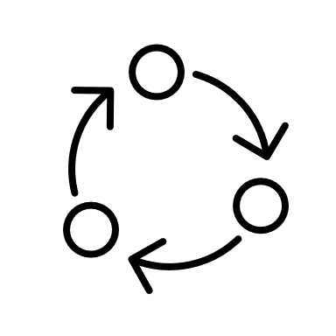
What can affect your designs?
16:9
Format
Text
Images/ Graphics
Color
We also have
Pacing
Interactions
Animation
Progression
Notes:
To begin, let’s talk about what can affect your design. It’s not just about pretty colors, cool images, what font you choose. Everything should be considered in your design process; such as how you are delivering the training. Text, and when I say text, I’m not talking about what words are typed or what it says, and not just what font is chosen, but text should also be thought of as shapes. I’ll show you an example later on during this discussion. Other elements include images, graphics, and color. As instructional developers, we also have unique elements that we can use to affect our design process. Pacing, adding interactions, animation, and how the user progresses in the course should be part of the design process.

Slide 7
C.R.A.P +P.M.
C R A P + P M
olors
ontrast
C.R.A.P. is an acronym for contrast, repetition, alignment, and proximity; these are the four foundational principles of design developed by Robin P. Williams.
epetition
lignment
roximity
acing
Pacing and Movement are specific to the eLearning development process.
ovement
Notes:
CRAP stands for contrast, repetition, alignment and proximity. These are the basic foundational principles that a designer should always consider when designing anything, from flyers, billboards, and slides. These principles were developed by Robin Patricia Williams. For this presentation, I’m going to change contrast to color. I feel it fits better with what I will be covering.
PM stands for Pacing and Movement. These are 2 additional principles that I feel can affect how we design our training and should be part of our process in training development.

Slide 8
Colors
Color Palette
Colors chosen and organized in a deliberate manner to create a visually harmonious and aesthetically pleasing design.
How do these color sets make you feel?
Contrast/Emphasis
Highlight important information, such as key concepts, headings, or actionable items.
Emphasize important words.
Warning!
Click Here!
Accessibility
Helps ensures that the training course is inclusive and usable by all learners.
Can you read this?
Can you read this?
Can you read this?
Emotional Impact
Colors evoke emotions and can influence learner engagement and retention.
Did you know the color palettes fast food restaurants use are created to make you hungry?
Notes:
Color plays an important role in your design and should be a major step in your development process. Color can influence mood, grab attention, and help with comprehension, ultimately enhancing the overall learning experience.
A color palette refers to a set of colors chosen and organized in a deliberate manner to create a visually harmonious and aesthetically pleasing design. Selecting a color palette can influence the overall design and feel of the course. For example, an onboarding course using bright colors will be more inviting and seem more exciting than desaturated or dull colors. And sticking to a color palette helps you with other design principles such as repetition and consistency and also helps with efficiency because you know what colors you are going to be using throughout the course. It’s best to keep your color set to a maximum of 5 colors, 2 primary colors and 2-3 ascent and/or complementary colors. Does this mean that you can’t use certain colors if they are not in your set? Like red for incorrect, green for correct? No, but those are colors used for specific reasons.
Contrast: Contrast between different colors can be used to highlight important information, such as key concepts, headings, or actionable items. High contrast between text and background colors improves readability and ensures content is easily distinguishable.
Accessibility: Consideration of color accessibility is crucial to ensure that the training course is inclusive and usable by all learners, including those with color vision deficiencies. Using accessible color combinations helps ensure that content is readable by all learners. There are online tools to check if the colors used in your text are accessible and readable.
Emotional Impact: Colors evoke emotions and can influence learner engagement and retention. Understanding color psychology can help you choose appropriate color schemes that align with the desired emotional tone of the training course. For example, warm colors like red and orange may convey energy and excitement, while cool colors like blue and green may evoke a sense of calmness and concentration. Hunger is an emotion too. A majority of fast-food restaurants use bright colors like orange and yellow in their advertisements and color sets because it makes people want to eat.

Slide 9
Exercise 1
What color palette would be appropriate for this course?
Notes:
This is a slide from an OSHA training course on Industrial Hygiene. The course was found on the OSHA website.
First color set – Searched for OSHA – Canva color generator
Second set – Searched for Danger Canva color generator
Third set was Safety. Adobe color generator
The first set of colors is too saturated, and the bright colors would be very difficult to design around and also could cause eye fatigue in users. The second set is ok, but it doesn’t fit the tone of the course. The last color is the best. It has good primary, secondary, and ascent colors. It has good contrast.

Slide 10
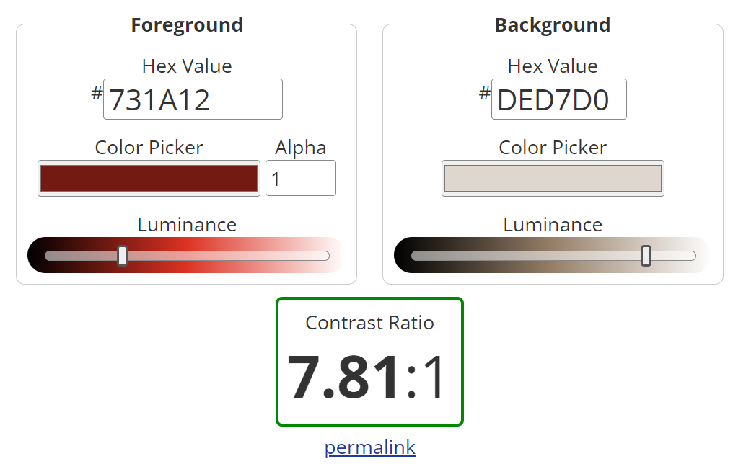
Exercise 1
Do the colors provide good contrast/emphasis?
Is it accessible?
https://webaim.org/resources/contrastchecker/
Is the color tone appropriate? (emotion)

Slide 11
Examples

Slide 12
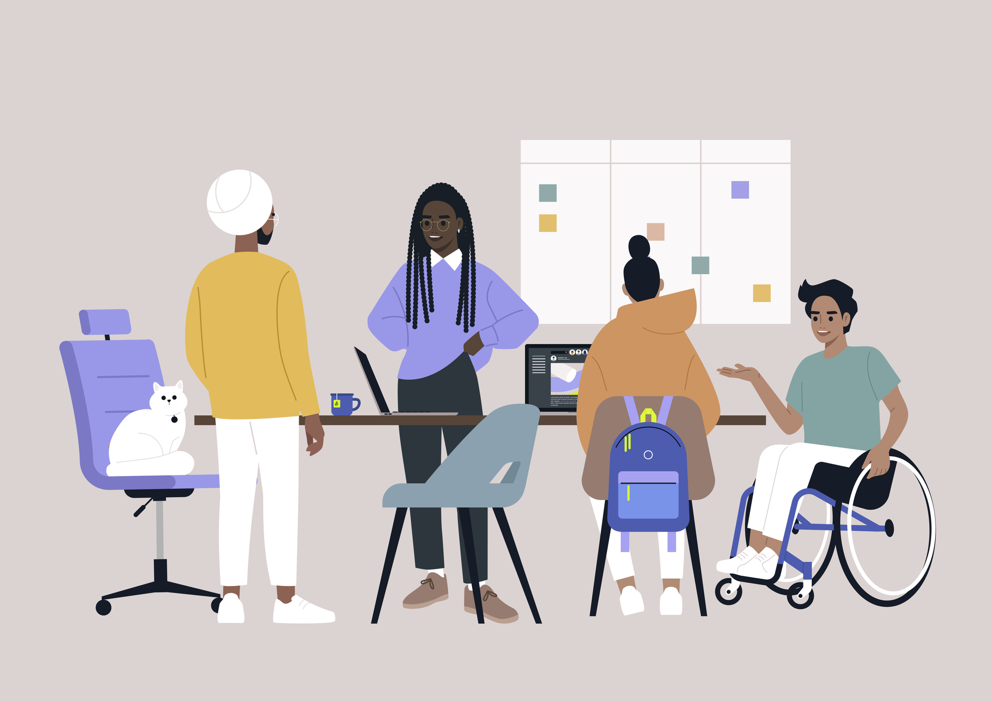
Repetition
Consistency/Unity
Helps create a cohesive visual identity and reinforces branding.
The same button style was used throughout the course for consistency.
Fonts
Impacts how your design and helps reinforce the message and tone of your visual style.
Primary Font
Used for your body text.
Secondary Font
Headings, subtitles, callout boxes.
Ascent Font
Decorative font used sparingly.
Images/Icons/Graphics
The style of your images is just as important as what is on your images.
Different image effects on the same image.
Different styles of images on the same topic.
Notes:
How many of you have taken a course and it seems like each slide is a completely different course. The buttons look different from one slide to the next, the popups function differently, a completely different set of colors and fonts are used throughout the course?
Repetition is the consistent use of visual elements throughout the course materials to create unity, coherence, and reinforce key concepts. Repetition plays a vital role in enhancing the effectiveness of training courses by establishing familiarity, aiding in organization, and reinforcing learning objectives.
Consistency in design elements helps create a cohesive visual identity and reinforces branding, if applicable. Consistent design elements such as colors, fonts, icons, and graphical styles across different slides, modules, popups, buttons, or elements within the training course. Stick with 1-2 different variations of designs for your buttons and popups and only use a different design if absolutely necessary.
Fonts are not just fonts, they have big impact on how your user perceives your design and helps reinforce the message and tone of your visual style. Fonts should be limited to 2 to 3 fonts.
A primary font for the majority of the text. This font should be highly readable and versatile enough to use for body text and other textual elements that will have your main content.
A secondary font to complement the primary font and add variety to the design. The secondary font can be used sparingly for specific purposes such as headings, subheadings, or callout boxes.
An Accent font. The accent font is optional. This is mainly used for decorative or specialized purposes. However, it's essential to use the accent font sparingly and ensure that it complements the primary and secondary fonts without overshadowing them.
Images, icons, and any other graphical elements should maintain the same style. Other than assisting with maintaining unity and cohesions of the course, it can help creating the courses more efficiently. Once established, a set of consistent styles can be applied across multiple modules or courses, saving time and effort in the development process. It also helps create a polished and professional look. Look at examples.

Slide 13
Exercise 2
What consistent elements can we implement?
Fonts, Images, and Colors
What fonts/font sets would reinforce the tone?
Serif
Sans-Serif
Decorative
How can we improve the images/graphics?

Slide 14
Exercise 2
Colors are used consistently. Icons are consistent.
Georgia (Serif) is used for headers and non-context text.
Tahoma (Sans-Serif) is used for context and important text.
Image has a desaturated look and vignette on it. Matches the tone and colors.

Slide 15
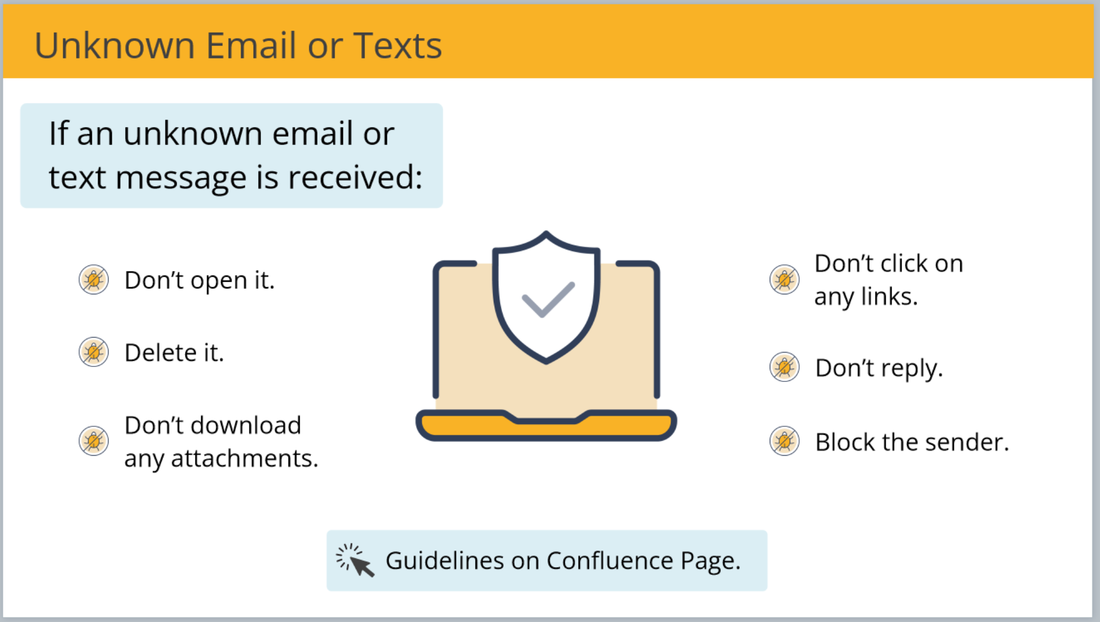
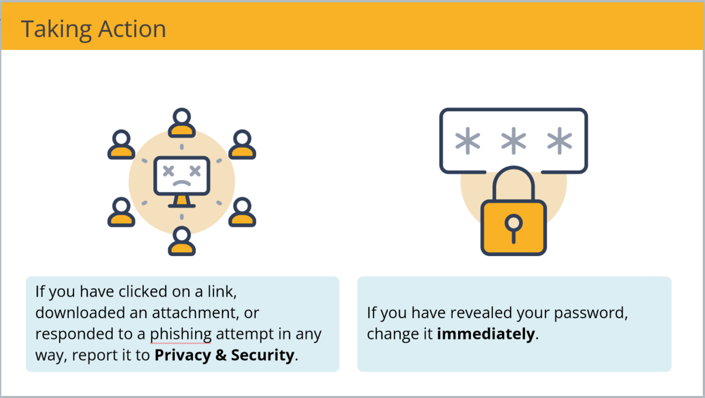
Examples

Slide 16
Alignment
Organization
Makes it easier for learners to navigate and understand the content.
Balance
Help maintain focus on what’s important.
Visual Flow
Directs the user’s attention and helps to view the information in the correct order.
Notes:
Aligning elements such as text, images, and graphics consistently throughout the training course creates a sense of order and professionalism. Consistent alignment ensures that the design appears deliberate and well-planned, enhancing the overall visual appeal of the materials.
Alignment helps organize the layout of the training course, making it easier for learners to navigate and understand the content. Aligning elements along a grid or axis creates a structured and predictable layout that enhances readability and comprehension.
Alignment helps create balance within your slides. Balance in your slides help maintain focus on what’s important. Text, images, and other graphics should be laid out evenly to prevent the overall design from feeling off balance. Balancing includes the sizes of elements compared to other elements in the course.
Visual flow is how the users' eyes are directed and to help them view the information in the proper order. In the Western hemisphere, we read from left to right and top to bottom. We need to use this to help direct the user’s attention in the way we want them to view the material.

Slide 17
Exercise 3
Is the information /images /graphics organized?
Is the slide visually balanced/aligned
How is the visual flow?

Slide 18
Exercise 3
Text and images are organized.
Header, body text, and graphics are aligned and equally spaced. (Use 960Grid system)
Visual flow is improved with good spacing.
Notes:
I left aligned the header to improve visual flow and align with the body text. I also moved the image slightly to the right to give a little more breathing room.
All graphics and text are aligned equally using the 960Grid tool and practices.
Visual flow is smoother and not so erratic.

Slide 19
Examples

Slide 20
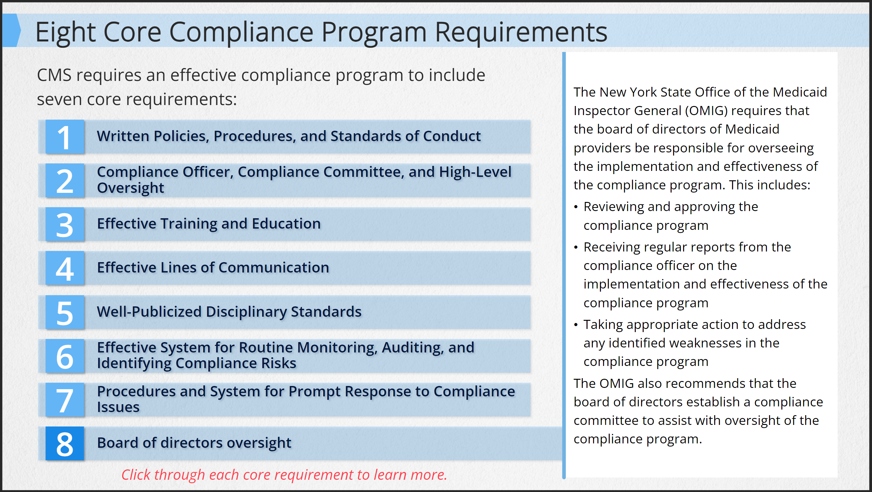
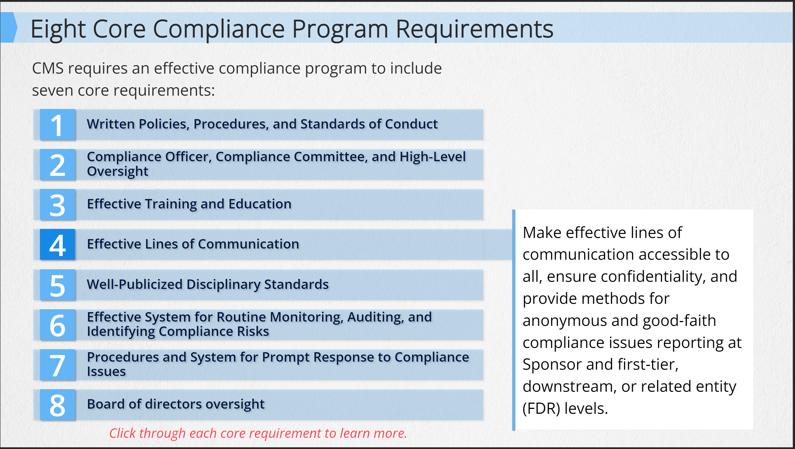
Proximity
Grouping creates relationships
Organize related content elements into cohesive and visually distinct groups.
Grouping related items makes it easier to understand relationships.
Reduce Cognitive Load
Helps reduce cognitive load for learners by making it easier to process information.
How much easier is it to count the different shapes? Different colors?
Notes:
Proximity refers to the spatial relationship between visual elements within a layout. Proximity dictates how closely related elements are grouped together, based on their relevance or relationship to one another. This principle emphasizes organizing related elements in close proximity to each other to visually connect them and communicate their association effectively.
Grouping Related Content: Proximity helps organize related content elements, such as text, images, and graphics, into cohesive and visually distinct groups. By placing related elements close to each other, instructional developers signal to learners that these elements are connected and belong together, facilitating comprehension and understanding of the course materials.
Reducing Cognitive Load: Grouping related content elements in close proximity reduces cognitive load for learners by making it easier to process information. When relevant elements are placed together, learners can quickly grasp the connections between them and understand their significance without having to search for related content scattered throughout the layout. Look at the example on screen. You can quickly count or read the number of circles, triangles, and hearts. It’s also easy to see how many colors are of each.

Slide 21
Exercise 4
How is this slide organized?
How is this slide grouped?
Notes:
This slide isn’t a great example of proximity, but you can still apply some of the principles. The text is grouped to the left of the image which only plays a decorative role. The header and footer are separated from the main text by using a different background color. The main text is further broken into separate sections, the intro text, the “bullet points” and the exit text. The bullet points are the only text with icons next to it and helps break or separate the intro and exit text.

Slide 22
Exercise 4
What do you look at first? What do you look at next? What’s important?

Slide 23
Exercise 4
What do you look at first? What do you look at next? What’s important?
Notes:
Once everything is organized, you have room to add additional details if you need to.
One thing I would change is the Liquids image. The image looks off or staged compared to the other two. I would find an image that more closely matches the other 3 in tone.

Slide 24
Examples

Slide 25
Pacing
Chunking
Break down large amounts of information into smaller, more manageable chunks or segments.
Interactions
Break up passive learning experiences and provide learning opportunities.
Click Here
Control of Information Flow
Providing learners with control over the pace of information delivery.
Notes:
Pacing is a crucial aspect of training course development, encompassing various techniques such as chunking information, incorporating interactions, and controlling the flow of information. These pacing strategies play a significant role in enhancing learner engagement, comprehension, and retention.
Chunking involves breaking down large amounts of information into smaller, more manageable chunks or segments.
By chunking information, instructional developers can help prevent cognitive overload and facilitate better information processing by learners.
Each chunk typically represents a coherent and digestible unit of information, making it easier for learners to understand and remember.
Interactions break up passive learning experiences and provide opportunities for learners to apply their knowledge, receive feedback, and reinforce learning objectives.
Incorporating interactions not only enhances learner engagement but also allows instructional developers to assess learner progress and adjust the pacing of the course accordingly.
But beware, interactions shouldn’t be added to just make a course more “engaging”. Unnecessary interactions will slow the pace of the course down and could end up frustrating the learner.
Providing learners with control over the pace of information delivery is essential for accommodating individual learning preferences and needs.
Learners can review difficult concepts, skip ahead to sections of interest, or revisit previous content as needed, empowering them to take ownership of their learning journey.
Control of information also helps prevent feelings of overwhelm or frustration, as learners can adjust the pacing to match their cognitive processing abilities and time constraints.

Slide 26
Exercise 5
All the information is presented at the same time.
If there is narration, the reader wouldn’t know when the narrator is going to the next section.

Slide 27
Exercise 5
How is this slide organized?
How is this slide grouped?

Slide 28
Exercise 5
How is this slide organized?
How is this slide grouped?

Slide 29
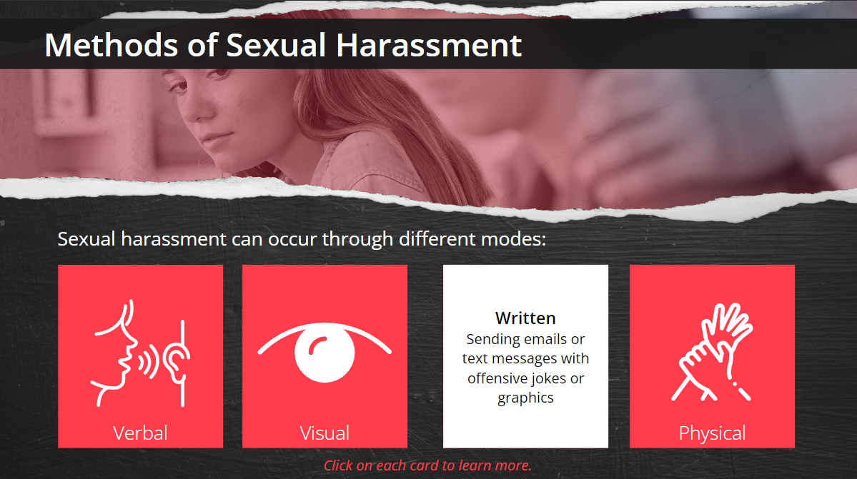
Examples

Slide 30
Movement
Guided Attention
Direct learners' attention to specific areas of the screen or highlight important information.
Look Here
Now Look Here
Visual Engagement
Capturing learners' attention and sustaining their focus throughout the learning experience.
Look Here
Look Here
Notes:
Movement can significantly enhance visual flow control and focus, contributing to a more engaging and effective learning experience.
Guiding Attention: Movement can be used to direct learners' attention to specific areas of the screen or highlight important information. By animating elements such as arrows, pointers, or visual cues, instructional developers can guide learners' focus towards key concepts, instructions, or interactive elements, ensuring that they do not miss critical information.
Visual Engagement: Dynamic animations add visual interest and engagement to the training course, capturing learners' attention and sustaining their focus throughout the learning experience. Movement can make the content more lively and interactive, fostering a sense of excitement and curiosity that motivates learners to explore and interact with the course materials. But beware of the Web 1.0 affect, when people learning how to code websites in the early internet days would animation to everything. (MySpace.com). You can easily oversaturate the design with meaningless animation.

Slide 31
Examples

Slide 32
Examples
Created by: Ascendant Design and Training, LLC

Slide 33
Tips and Tricks
Use Color Set Generators
Canva.com, Color.adobe.com, Coolors.co (Search for Color Set Generators)
Check Contrast Readability
https://webaim.org/resources/contrastchecker/
Use 960 Grid System for alignment
https://960.gs. The system is easy to use and should be part of all your projects.
Create a Developer’s Toolbox
Don’t just save your layouts, save any reusable asset (buttons, popups, fonts, colors.
20/80 Rule
Don’t burn yourself out. Give 20% of your project 80% of your effort, 80% of your project 20% of your effort.
Notes:
To make selecting a color set easier, use color set generators or sites that have existing color set.
Always check contrast readability for your text. If you do this early on, you’ll be able to choose what colors you use on your text and which you shouldn’t to avoid having to go back and redoing all your slides.
Use the 960 Grid System for alignment. Download the files, and use the PNG images as a background in your slide master. This way it will always be there for all your slides and you can simply just turn it off when you are down creating your slides.
Repeat after me, saved layouts are not templates. Save any reusable assets you create. I usually create an extra scene in Storyline or slide where I save all my buttons, popups, modal windows, fonts, color sets, and anything that I know I will be using again and again.
You can give a project your 100%, but you can’t give each slide 100%. You’ll burn yourself out trying to make each slide a masterpiece. About 20% of the slides or project should get about 80% of your effort. These portion is where you push the boundary of your creativity more than the rest of the course. The rest you create a baseline standard to maximize your output.

